Slide 1
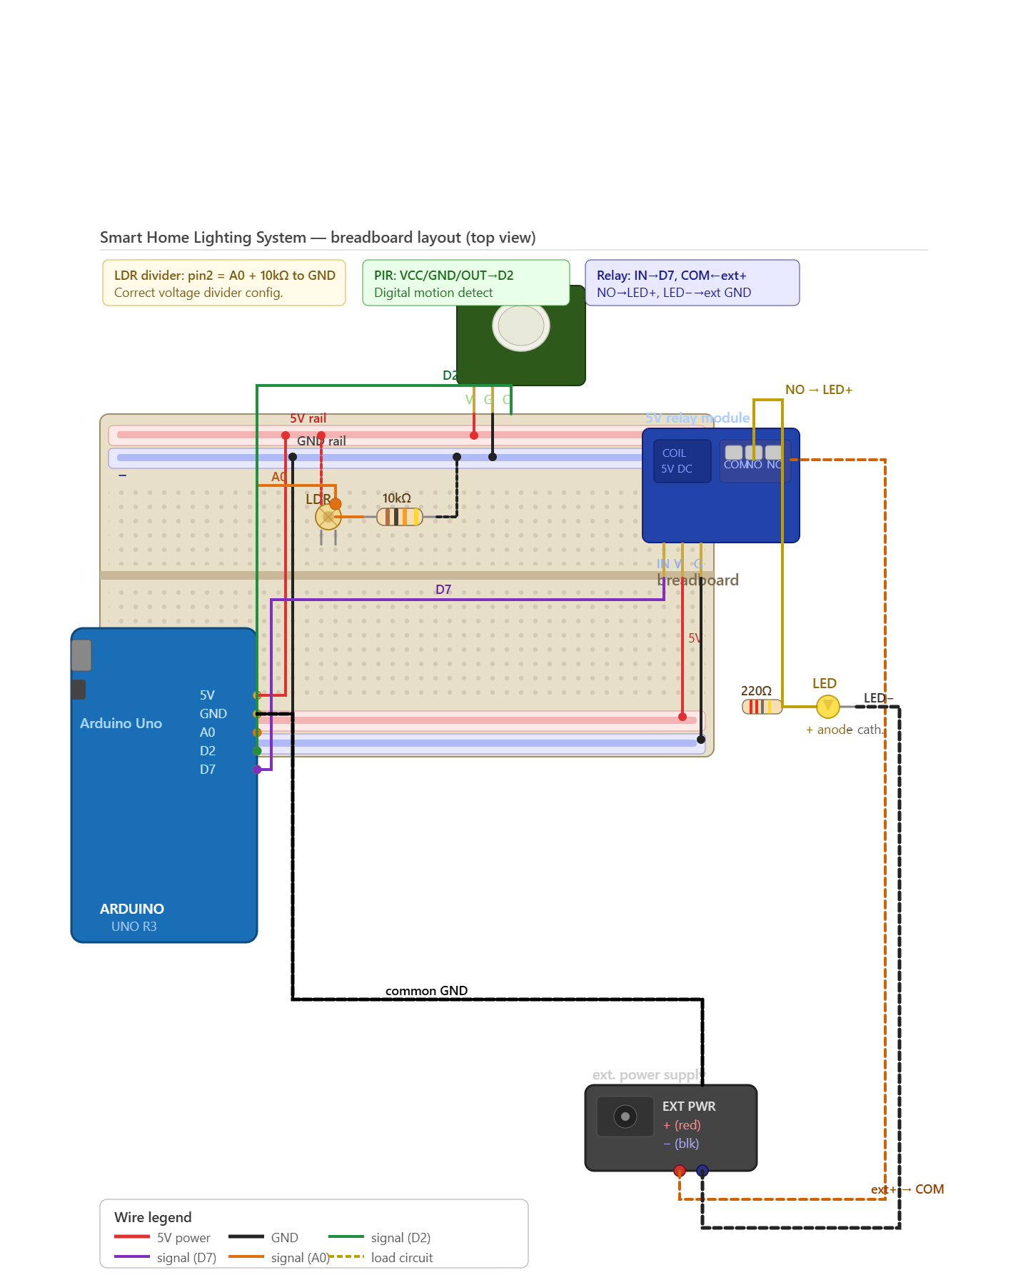
CIRCUIT DESIGN

Slide 2
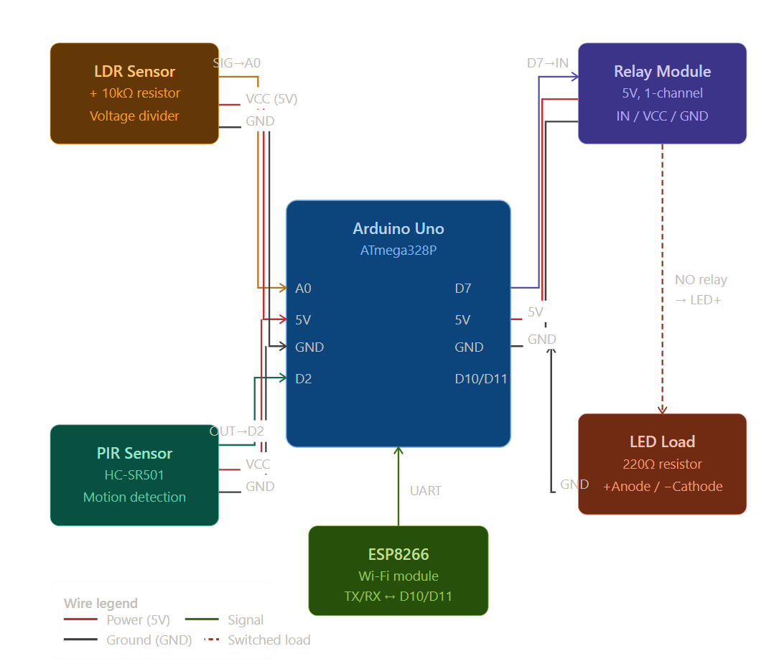
CIRCUIT FLOW DIAGRAM

